Slide 1
“Graph Algorithm”
Submitted by :- Rohit Kumar
Submitted to :- Chandresh Kumar Maurya

Slide 2
Table Of Content
Graph and Its Types
Breadth-First Algorithm
Depth-First Algorithm
Spanning Tree
Kruskal’s and Prim’s Algorithm
Shortest Path Algorithm (Dijkstra Algorithm)

Slide 3
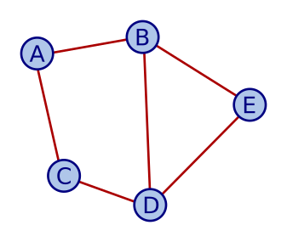
GRAPHS
Graph data structure consists of a finite set of vertices or nodes. The interconnected objects are represented by points termed as vertices, and the links that connect the vertices are called edges.

Slide 4
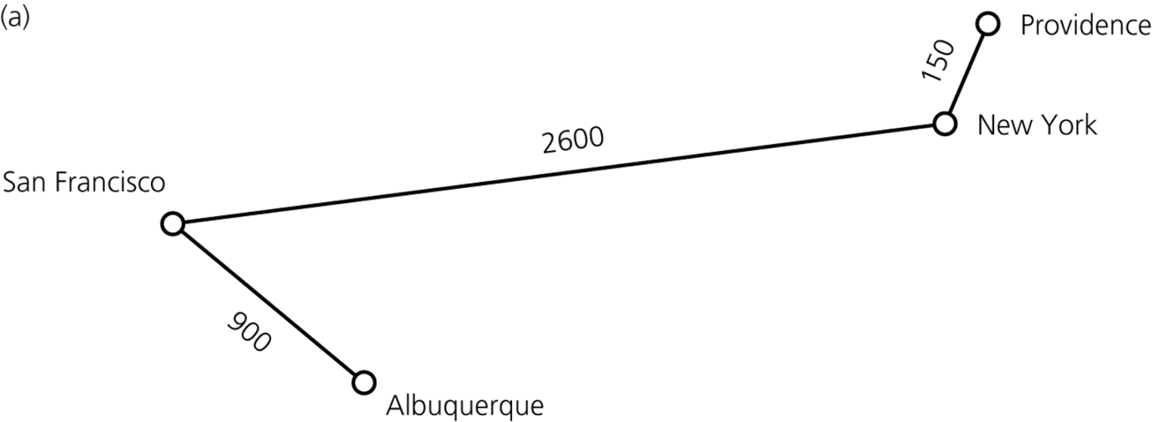
Weighted Graph
Weighted graph
A graph whose edges have numeric labels

Slide 5
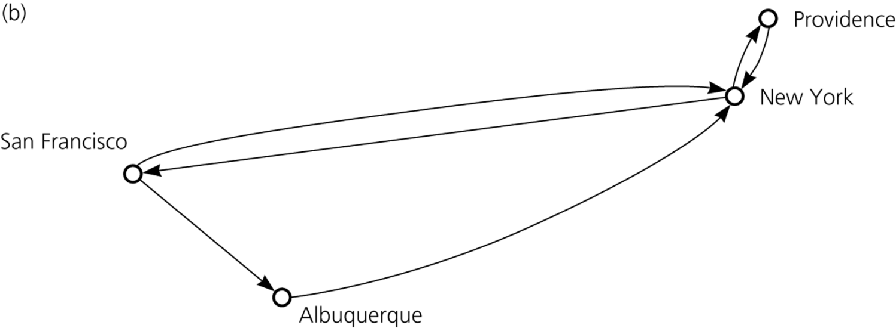
Directed And Undirected Graphs
Undirected graph
Edges do not indicate a direction
Directed graph, or diagraph
Each edge is a directed edge

Slide 6
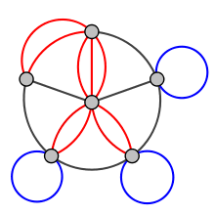
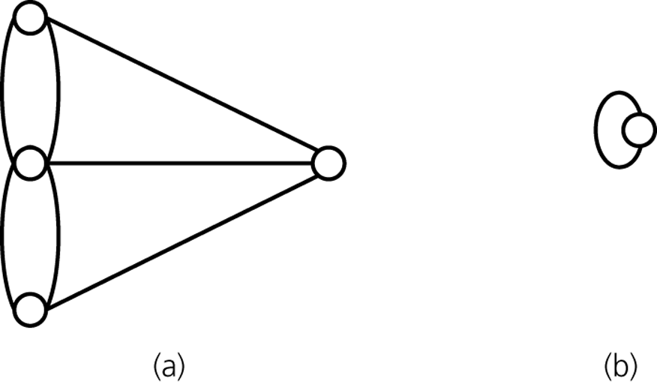
Multigraph
Multigraph
Not a graph
Allows multiple edges between vertices
a) A multigraph is not a graph
b) A self edge is not allowed in a graph

Slide 7
Degrees Summary
number of edges connected to a vertex
for undirected graphs
sum of all degrees = 2 X edges
the number of nodes with odd numbered degrees is even?
for directed graph
sum of in-degree = sum of out-degree

Slide 8
Connectivity
connected
there exists a path between every pair of vertices
articulation vertex
deleting this vertex makes the graph disconnected
a graph without any such vertex is biconnected
deleting a bridge edge makes the graph disconnected

Slide 9
Cycles
A tree does not have a cycle
Euler path
a tour that visits every edge exactly once
Hamilton path
a tour that visits every vertex exactly once

Slide 10
Breadth-First Search

Slide 11
Breadth-First Search
Visits every vertex adjacent to a vertex v that it can before visiting any other vertex
A first visited, first explored strategy
An iterative form uses a queue
A recursive form is possible, but not simple

Slide 12
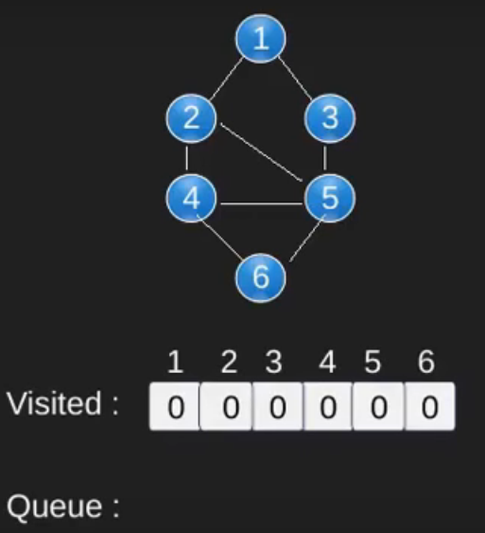
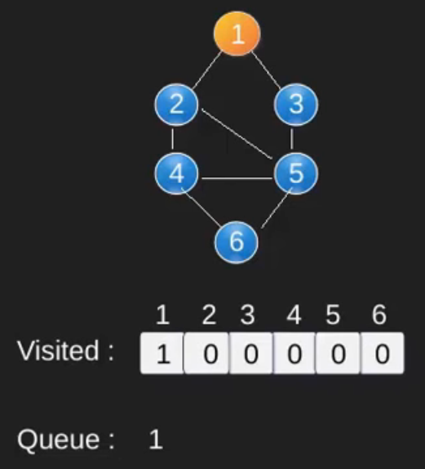
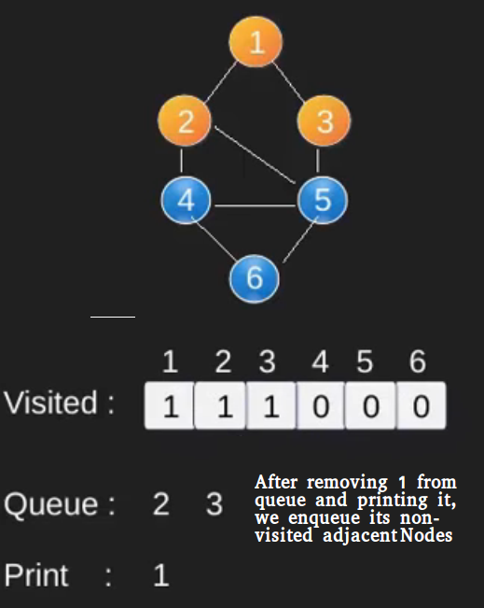
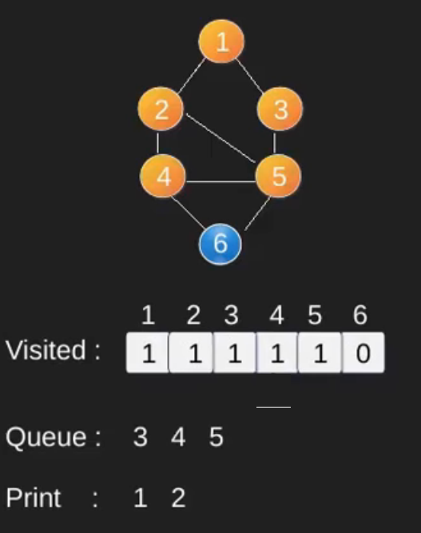
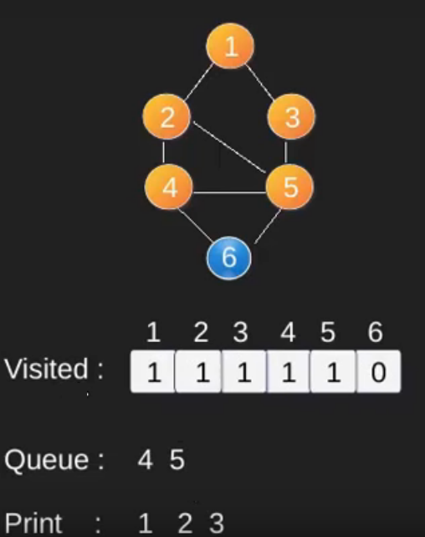
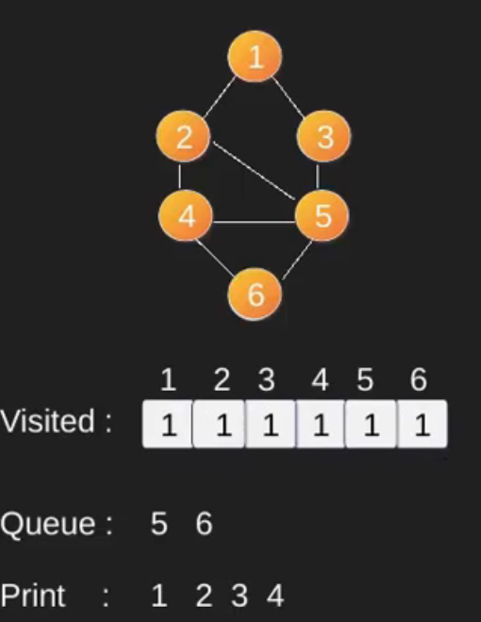
BFS EXAMPLE

Slide 13
BFS Algorithm
BFS (V,E,s)
for each vertex v in V – {s}
do
color[v] ← WHITE
d[v] ← ∞
π[v] ← NIL
color[s] = GREY
d[s] ← 0
π[s] ← NIL
Q ← { }
ENQUEUE (Q,s)
While Q is non-empty
do v ← DEQUEUE (Q)
for each u adjacent to v
do if color[u] ← WHITE
then color[u] ← GREY
d[u] ← d[v] + 1
π[u] ← v
ENQUEUE (Q,u)
color[v] ← BLACK

Slide 14
Depth-First Search

Slide 15
Depth-First Search
Depth-first search (DFS) traversal
Proceeds along a path from v as deeply into the graph as possible before backing up
Does not completely specify the order in which it should visit the vertices adjacent to v
A last visited, first explored strategy

Slide 16
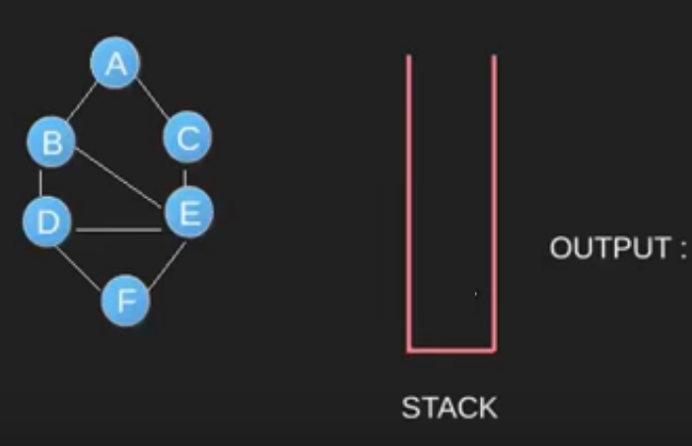
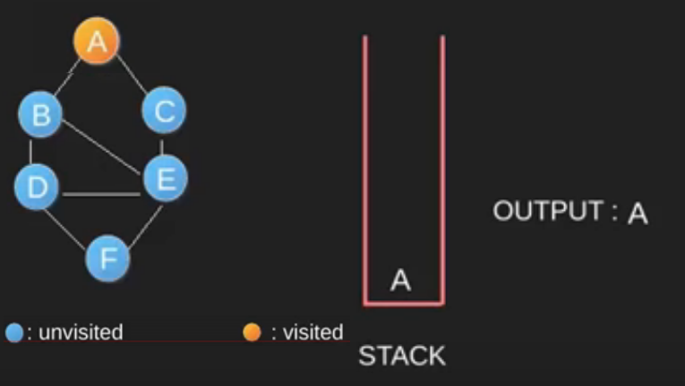
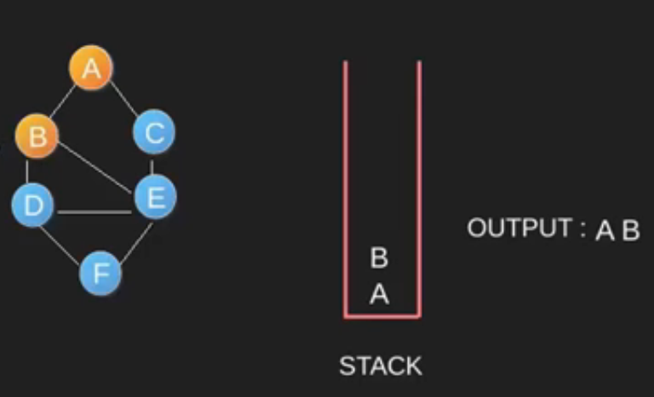
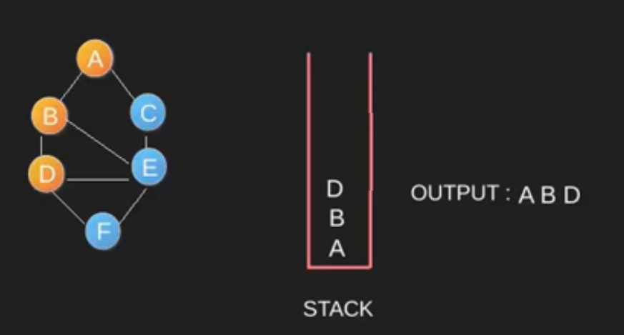
DFS Example
.

Slide 17
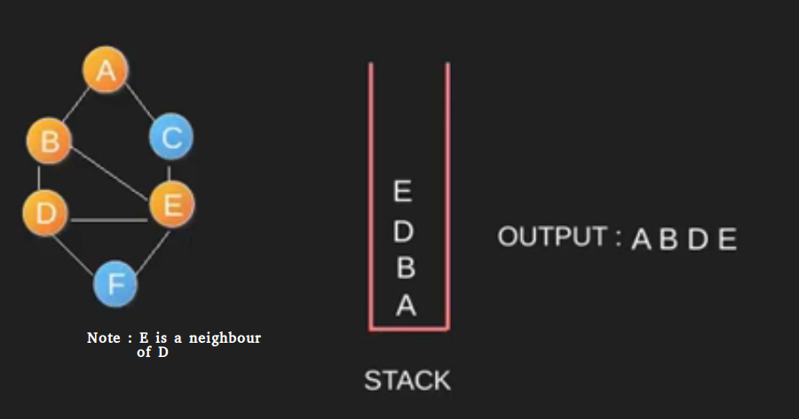
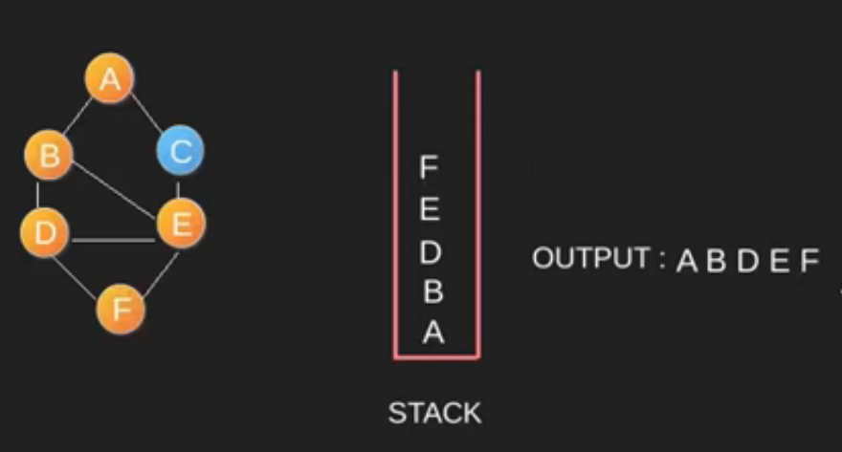
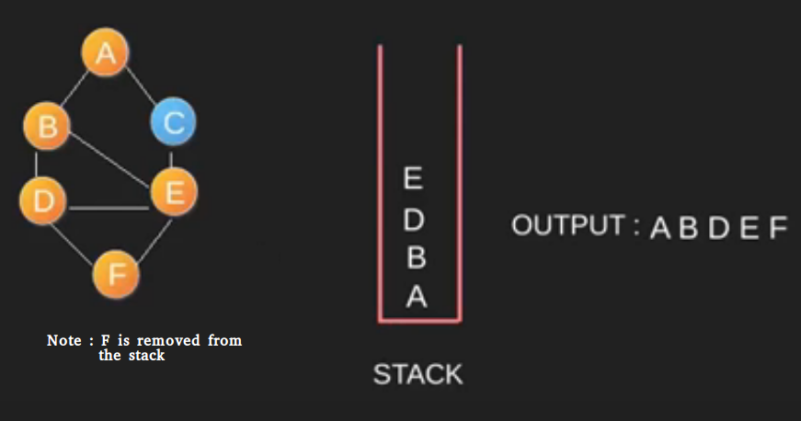
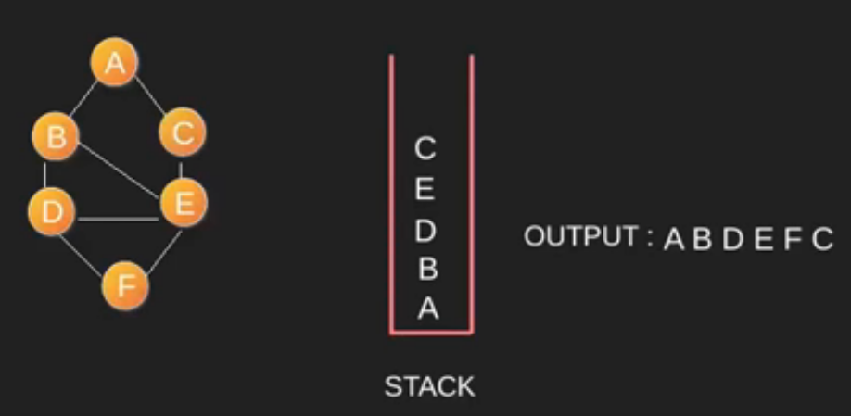
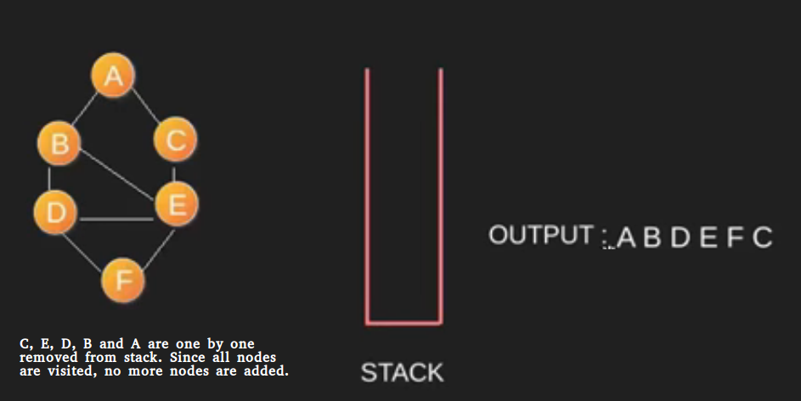

Slide 18
DFS Algorithm
DFS (V,E)
for each vertex u in V[G]
do color[v] ← WHITE
π[v] ← NIL
time ← 0
for each vertex v in V[G]
do if color[v] ← WHITE
then Depth_First_Search(v)
Depth_First_Search (v)
color[v] ← GRAY
time ← time + 1
d[v] ← time
for each vertex u adjacent to v
do if color[u] ← WHITE
π[u] ← v
Depth_First_Search(u)
color[v] ← BLACK
time ← time + 1
f[v] ← time

Slide 19
Spanning Tree

Slide 20
Spanning Trees
A tree
An undirected connected graph without cycles
A spanning tree of a connected undirected graph G
A subset of G, which has all the vertices covered with minimum possible number of edges
To obtain a spanning tree from a connected undirected graph with cycles
Remove edges until there are no cycles

Slide 21
Spanning Tree
You can determine whether a connected graph contains a cycle by counting its vertices and edges
A connected undirected graph that has n vertices must have at least n – 1 edges
A connected undirected graph that has n vertices and exactly n – 1 edges cannot contain a cycle
A connected undirected graph that has n vertices and more than n – 1 edges must contain at least one cycle

Slide 22
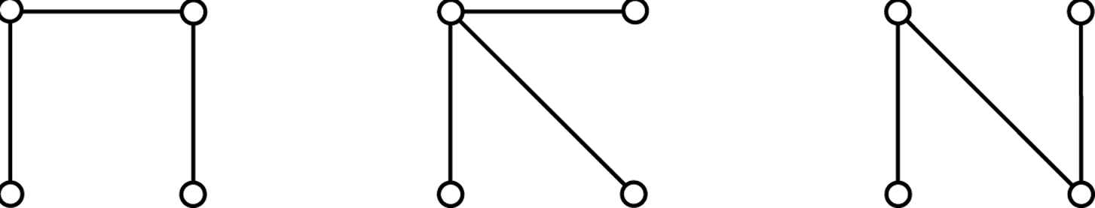
Spanning Tree
Figures
Connected graphs that each have four vertices and three edges

Slide 23
Minimum Spanning Trees
Minimum spanning tree for weighted graphs
A spanning tree for which the sum of its edge weights is minimal
Prim’s algorithm
Finds a minimal spanning tree that begins at any vertex
Strategy
Find the least-cost edge (v, u) from a visited vertex v to some unvisited vertex u
Mark u as visited
Add the vertex u and the edge (v, u) to the minimum spanning tree
Repeat the above steps until there are no more unvisited vertices

Slide 24
Prim’s Algorithm

Slide 25
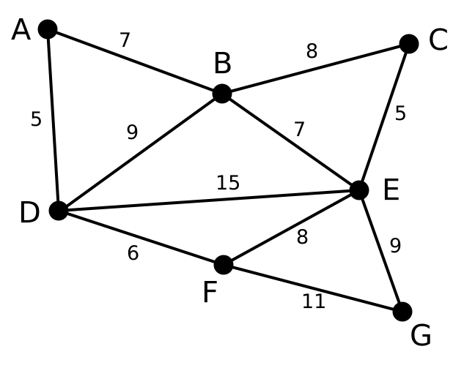
Example of MST: Prim’s Algorithm

Slide 26
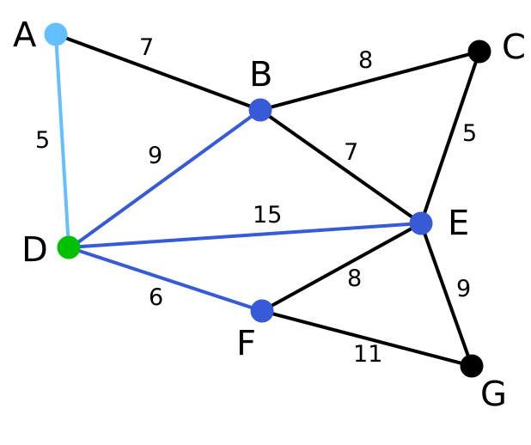
Vertex D has been chosen as a starting point
Vertices A, B, E, F are connected to D through a single edge.
A is the nearest to D and thus chosen as the 2nd vertex along with the edge AD

Slide 27
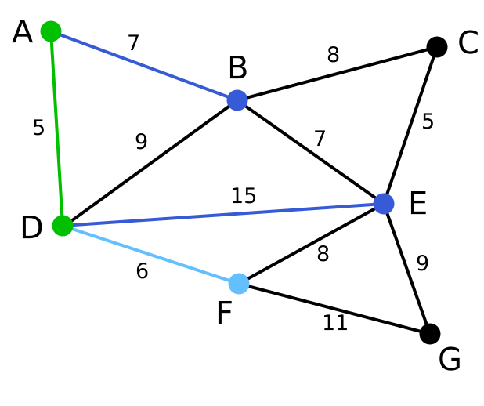
The next vertex chosen is the vertex nearest to either D or A. So the vertex F is chosen along with the edge DF

Slide 28
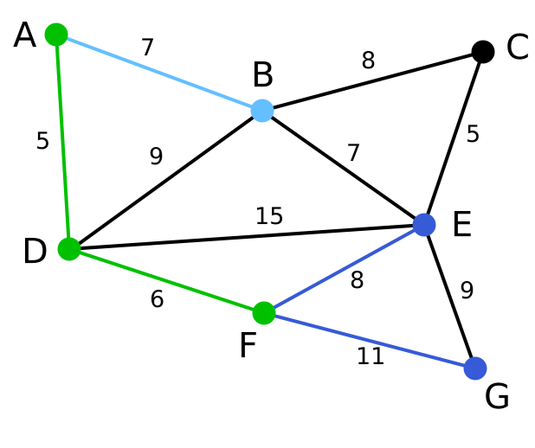
same as 2, Vertex B is chosen.

Slide 29
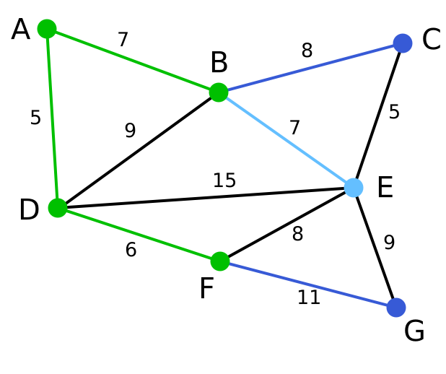
among C, E, G, E is chosen.

Slide 30
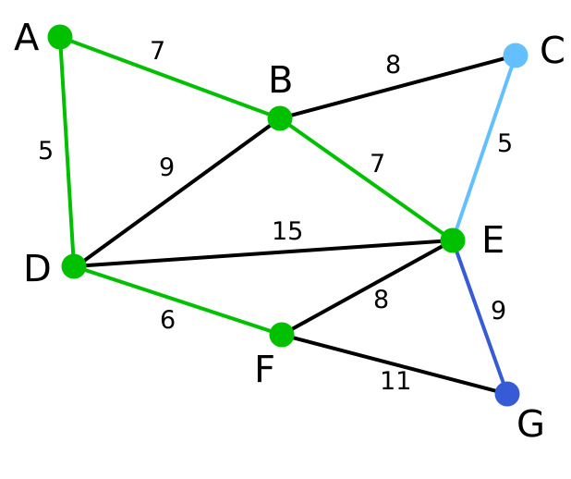
among C and G, C is chosen.

Slide 31
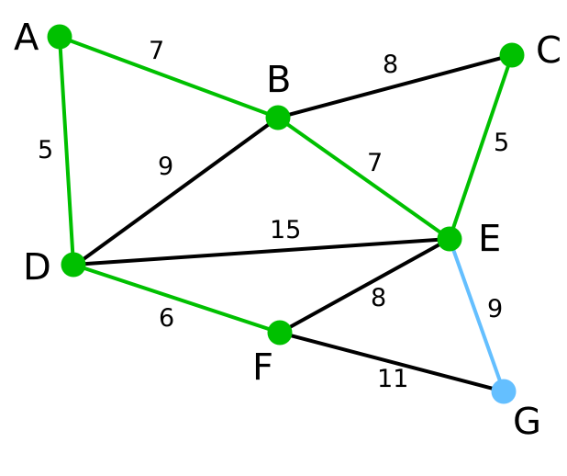
G is the only remaining vertex.

Slide 32
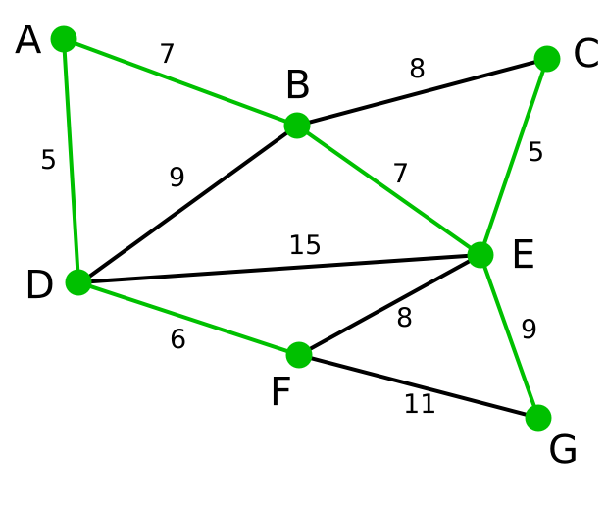
The finally obtained minimum spanning tree
⇒ the total weight is 39

Slide 33
dist: array of distances from the source to each vertex
edges: array indicating, for a given vertex, which vertex in the tree it is closest to
i: loop index
F: list of finished vertices
U: list or heap of unfinished vertices
/* initialization */
for i=1 to |V|
dist[i] = INFINITY
edges[i] = NULL
end for
pick a vertex s to be the seed for the MST
dist[s] = 0
while(F is missing a vertex)
pick the vertex v in U with the shortest edge and add v to F
for each edge of v, (v1, v2)
if (length(v1, v2) < dist[v2])
dist[v2] = length(v1, v2)
edges[v2] = v1
possibly update U, depending on implementation
end if
end for
end while

Slide 34
Kruskal’s Algorithm

Slide 35
Kruskal’s Algorithm
Kruskal’s Algorithm is a famous greedy algorithm.
It is used for finding the Minimum Spanning Tree (MST) of a given graph.
To apply Kruskal’s algorithm, the given graph must be weighted, connected and undirected.

Slide 36
Implementation
Step-01:
Sort all the edges from low weight to high weight.
Step-02:
Take the edge with the lowest weight and use it to connect the vertices of graph.
If adding an edge creates a cycle, then reject that edge and go for the next least weight edge.
Step-03:
Keep adding edges until all the vertices are connected and a Minimum Spanning Tree (MST) is obtained

Slide 37
Solution:-
To construct MST using Kruskal’s Algorithm,
Simply draw all the vertices on the paper.
Connect these vertices using edges with minimum weights such that no cycle gets formed

Slide 38
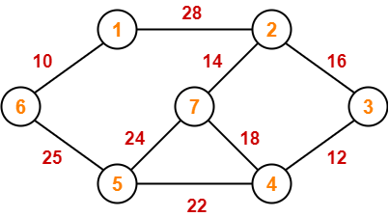
Example of Kruskal’s Algorithm

Slide 39
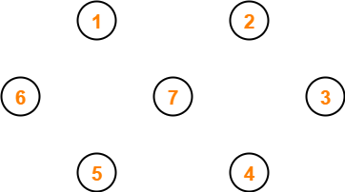
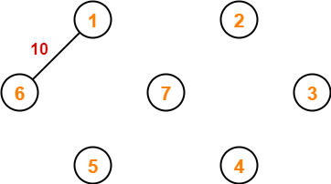
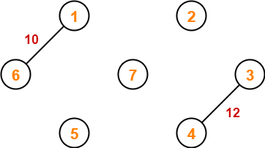
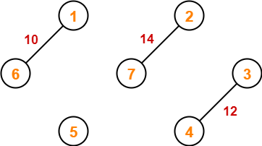
Step-01:
Step-02:
Step-03:
Step-04:

Slide 40
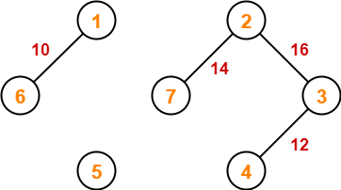
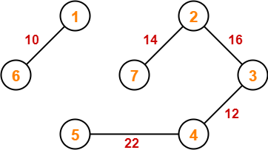
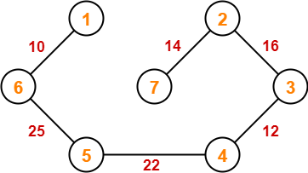
Step-05:
Step-06:
Step-07:

Slide 41
Shortest Paths

Slide 42
Shortest Paths
Shortest path between two vertices in a weighted graph
The path that has the smallest sum of its edge weights
Dijkstra’s shortest-path algorithm
Determines the shortest paths between a given origin and all other vertices
Uses
A set vertexSet of selected vertices
An array weight, where weight[v] is the weight of the shortest (cheapest) path from vertex 0 to vertex v that passes through vertices in vertexSet

Slide 43
Djikstra’s Algorithm
Dijkstra's algorithm - is a solution to the single-source shortest path problem in graph theory.
Works on both directed and undirected graphs. However, all edges must have nonnegative weights.
Approach: Greedy
Input: Weighted graph G={E,V} and source vertex, such that all edge weights are nonnegative
Output: Lengths of shortest paths (or the shortest paths themselves) from a given source vertex to all other vertices

Slide 44
Conditions
It is important to note the following points regarding Dijkstra Algorithm :-
Dijkstra algorithm works only for connected graphs.
Dijkstra algorithm works only for those graphs that do not contain any negative weight edge.
The actual Dijkstra algorithm does not output the shortest paths.
It only provides the value or cost of the shortest paths.
By making minor modifications in the actual algorithm, the shortest paths can be easily obtained.
Dijkstra algorithm works for directed as well as undirected graphs.

Slide 45
Step-01:
In the first step. two sets are defined-
One set contains all those vertices which have been included in the shortest path tree.
In the beginning, this set is empty.
Other set contains all those vertices which are still left to be included in the shortest path tree.
In the beginning, this set contains all the vertices of the given graph.
Step-02:
For each vertex of the given graph, two variables are defined as-
Π[v] which denotes the predecessor of vertex ‘v’
d[v] which denotes the shortest path estimate of vertex ‘v’ from the source vertex.
Initially, the value of these variables is set as-
The value of variable ‘Π’ for each vertex is set to NIL i.e. Π[v] = NIL
The value of variable ‘d’ for source vertex is set to 0 i.e. d[S] = 0
The value of variable ‘d’ for remaining vertices is set to ∞ i.e. d[v] = ∞
Step-03:
The following procedure is repeated until all the vertices of the graph are processed-
Among unprocessed vertices, a vertex with minimum value of variable ‘d’ is chosen.
Its outgoing edges are relaxed.
After relaxing the edges for that vertex, the sets created in step-01 are updated.

Slide 46
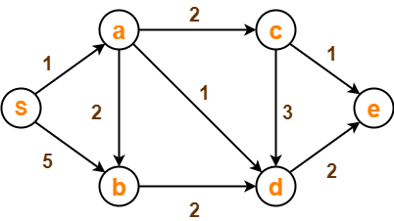
Example of Dijkstra’s Algorithm

Slide 47
SOLUTION :-
Step-01:
The following two sets are created-
Unvisited set : {S , a , b , c , d , e}
Visited set : { }
Step-02:
The two variables Π and d are created for each vertex and initialized as-
Π[S] = Π[a] = Π[b] = Π[c] = Π[d] = Π[e] = NIL
d[S] = 0
d[a] = d[b] = d[c] = d[d] = d[e] = ∞
Step-03:
Vertex ‘S’ is chosen.
This is because shortest path estimate for vertex ‘S’ is least.
The outgoing edges of vertex ‘S’ are relaxed.

Slide 48
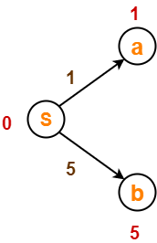
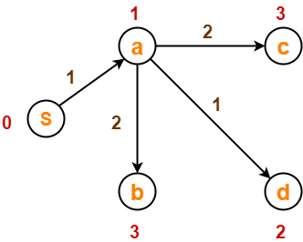
Step-04:
Vertex ‘a’ is chosen.
This is because shortest path estimate for vertex ‘a’ is least.
The outgoing edges of vertex ‘a’ are relaxed.

Slide 49
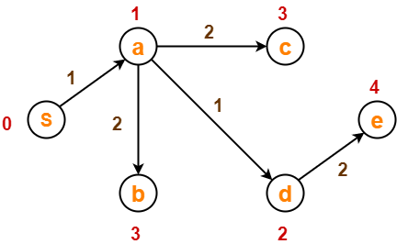
Step-05:
Vertex ‘d’ is chosen.
This is because shortest path estimate for vertex ‘d’ is least.
The outgoing edges of vertex ‘d’ are relaxed
Step-06:
Vertex ‘b’ is chosen.
This is because shortest path estimate for vertex ‘b’ is least.
Vertex ‘c’ may also be chosen since for both the vertices, shortest path estimate is least.
The outgoing edges of vertex ‘b’ are relaxed.

Slide 50
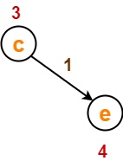
Step-07:
Vertex ‘c’ is chosen.
This is because shortest path estimate for vertex ‘c’ is least.
The outgoing edges of vertex ‘c’ are relaxed.
Step-08:
Vertex ‘e’ is chosen.
This is because shortest path estimate for vertex ‘e’ is least.
The outgoing edges of vertex ‘e’ are relaxed.
There are no outgoing edges for vertex ‘e’.
So, our shortest path tree remains the same as in Step-05.
Now, the sets are updated as-
Unvisited set : { }
Visited set : {S , a , d , b , c , e}

Slide 51
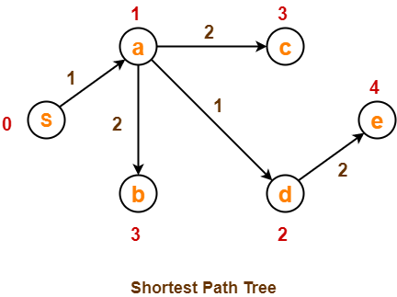
Now,
All vertices of the graph are processed.
Our final shortest path tree is as shown below.
It represents the shortest path from source vertex ‘S’ to all other remaining vertices.

Slide 52
Djikstra’s Algorithm
dist[S] ← 0 // The distance to source vertex is set to 0
Π[S] ← NIL // The predecessor of source vertex is set as NIL
for all v ∈ V - {S} // For all other vertices
do dist[v] ← ∞ // All other distances are set to ∞
Π[v] ← NIL // The predecessor of all other vertices is set as NIL
S ← ∅ // The set of vertices that have been visited 'S' is initially empty
Q ← V // The queue 'Q' initially contains all the vertices
while Q ≠ ∅ // While loop executes till the queue is not empty
do u ← mindistance (Q, dist) // A vertex from Q with the least distance is selected
S ← S ∪ {u} // Vertex 'u' is added to 'S' list of vertices that have been visited
for all v ∈ neighbors[u] // For all the neighboring vertices of vertex 'u'
do if dist[v] > dist[u] + w(u,v) // if any new shortest path is discovered
then dist[v] ← dist[u] + w(u,v) // The new value of the shortest path is selected
return dist

Slide 53
Floyd’s Warshall Algorithm

Slide 54
Floyd’s Warshall Algorithm
Floyd Warshall Algorithm is a famous algorithm.
It is used to solve All Pairs Shortest Path Problem.
It computes the shortest path between every pair of vertices of the given graph.
Floyd Warshall Algorithm is an example of dynamic programming approach.

Slide 55
When Floyd’s Warshall algorithm is used?
Floyd Warshall Algorithm is best suited for dense graphs.
This is because its complexity depends only on the number of vertices in the given graph.
For sparse graphs, Johnson’s Algorithm is more suitable.

Slide 56
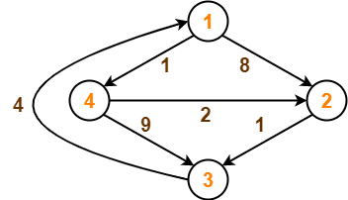
Example of Floyd’s Warshall Algorithm

Slide 57
Solution-
Step-01:
Remove all the self loops and parallel edges (keeping the lowest weight edge) from the graph.
In the given graph, there are neither self edges nor parallel edges.
Step-02:
Write the initial distance matrix.
It represents the distance between every pair of vertices in the form of given weights.
For diagonal elements (representing self-loops), distance value = 0.
For vertices having a direct edge between them, distance value = weight of that edge.
For vertices having no direct edge between them, distance value = ∞.

Slide 58
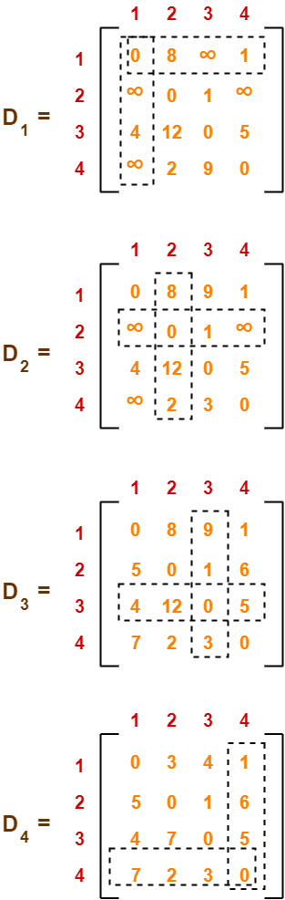
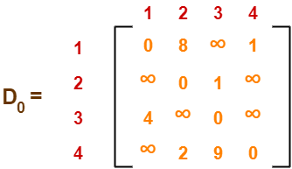
Initial distance matrix for the given graph is-
Step-03:
Using Floyd Warshall Algorithm, write the following 4 matrices:-
The last matrix D₄ represents the shortest path distance between every pair of vertices.

